Slide 1

References for the slides:
1. Data Mining: Concepts and Techniques
By Jiawei Han and Micheline Kamber
Simon Fras<number>er University, Canada
2. Slides of the book
Data Mining: Concepts and Techniques
By Jiawei Han and Micheline Kamber
Simon Fraser University, Canada
1

Slide 2
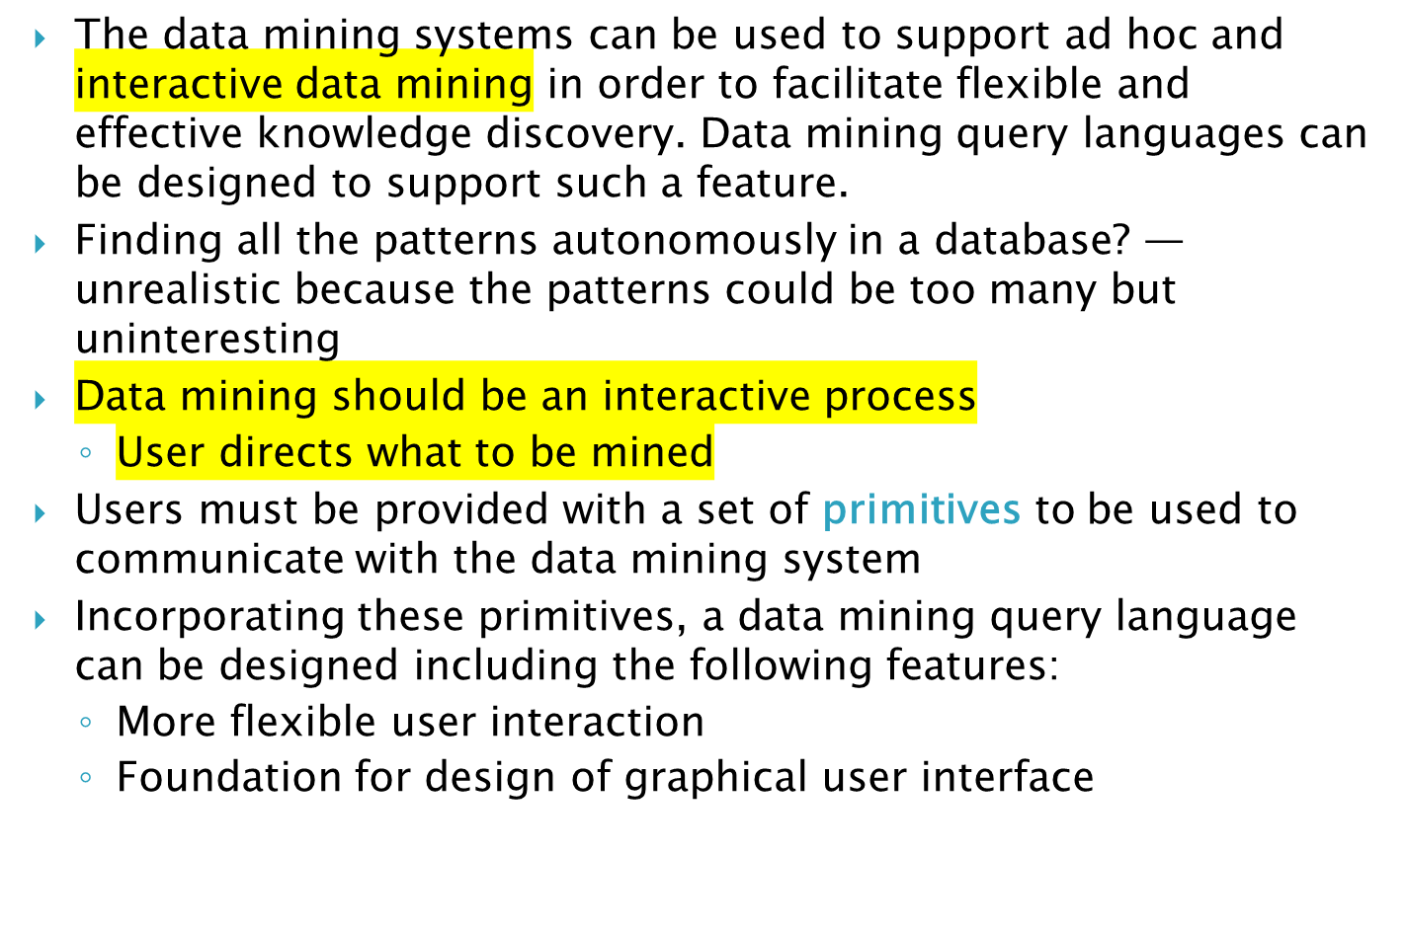

Slide 3
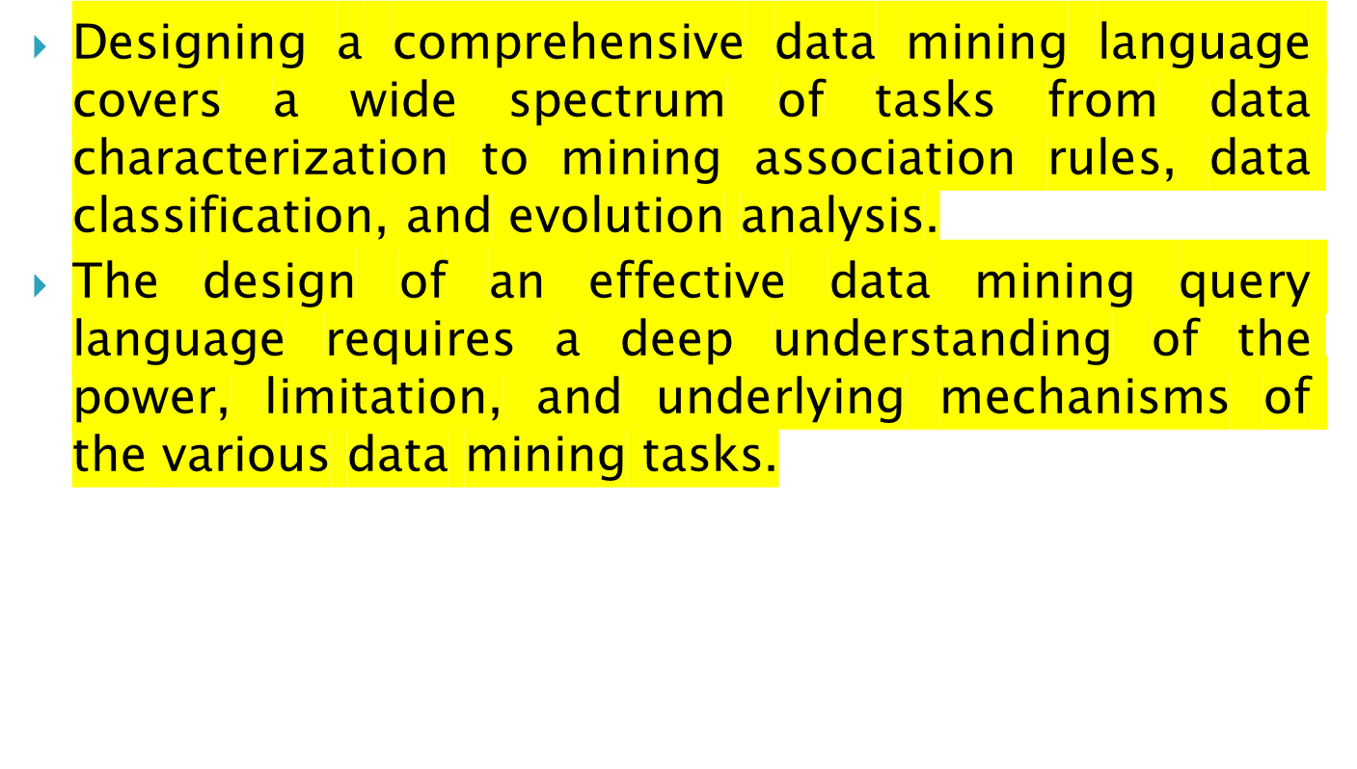

Slide 4
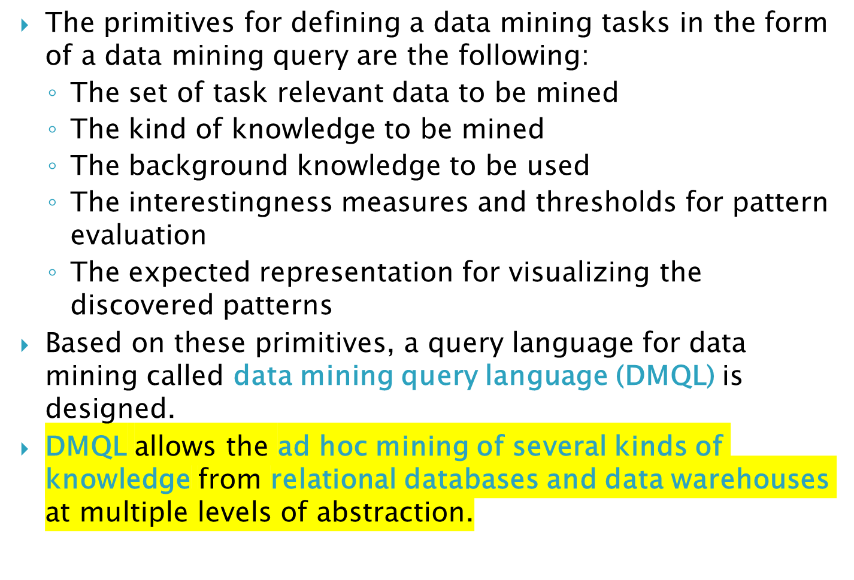

Slide 5
It is important to specify the kind of knowledge to be mined as this determines the data mining function to be performed. This includes:
  Characterization
  Discrimination
  Association
  Classification/prediction
  Clustering
  Outlier analysis
  Other data mining tasks

Slide 6
For data mining to be effective, data mining systems should be able to display the discovered patterns in multiple forms.
  e.g., rules, tables, pie/bar chart, decision trees etc.
Concept hierarchy is also important
  Discovered knowledge might be more understandable when represented at high level of abstraction
  Interactive drill up/down, pivoting, slicing and dicing provide different perspective to data
Different kinds of knowledge require different representation: association, classification, clustering, etc.

Slide 7
DMQL
  A DMQL provide the ability to support ad-hoc and interactive data mining of several kinds of knowledge from relational databases and data warehouses at multiple levels of abstraction.
  By providing a standardized language like SQL
    Hope to achieve a similar effect like that SQL has on relational database
    Foundation for system development and evolution
    Facilitate information exchange, technology transfer, commercialization and wide acceptance
Design
  DMQL is designed with the primitives described earlier

Slide 8
DMQL adopts an SQL-like syntax. In this syntax, [] represents 0 or one occurrences, {} represents 0 or more occurrences, and words in sans serif font represent keywords.
Defining a data mining task
Specification of the task relevant data, i.e., the data on which the mining is to be performed. This involves:
  Specifying the database and tables or data warehouse containing the relevant data
  Conditions for selecting the relevant data
  The relevant attributes or dimensions for exploration and
  Instructions for the ordering or grouping of the data retrieved

Slide 9
use database database_name, or use data warehouse data_warehouse_name
from relation(s)/cube(s) [where condition]
in relevance to att_or_dim_list
order by order_list
group by grouping_list
having condition

Slide 10
use database <database_name>: The use clause directs the mining task to the database as specified.
use data warehouse <data_warehouse_name>: The use clause directs the mining task to the data warehouse as specified.
From <relation(s)/cube(s)> [where <condition>]: The from and where clauses respectively specify the database tables or data cubes involved, and the conditions defining the data to be retrieved.
<DMQL> ::= <DMQL_Statement>; {<DMQL_Statement>}
<DMQL_Statement> ::= <Data_Mining_Statement>
| <Concept_Hierarchy_Definition_Statement>
| <Visualization_and_Presentation>

Slide 11
  use database AllElectronics_db
  use hierarchy location_hierarchy for B.address
  mine characteristics as customerPurchasing
  analyze count%
  in relevance to C.age, I.type, I.place_made
  from customer C, item I, purchases P, items_sold S, works_at W, branch B
  where I.item_ID = S.item_ID and S.trans_ID = P.trans_ID
    and P.cust_ID = C.cust_ID and P.method_paid = “AmEx''
    and P.empl_ID = W.empl_ID and W.branch_ID = B.branch_ID and B.address = “Canada" and I.price >= 100
  with noise threshold = 0.05
  display as table

Slide 12
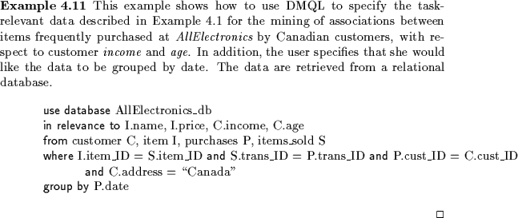
Specification of task-relevant data

Slide 13
E. Baralis and G. Psaila. Designing templates for mining association rules. Journal of Intelligent Information Systems, 9:7-32, 1997.
Microsoft Corp., OLEDB for Data Mining, version 1.0, http://www.microsoft.com/data/oledb/dm, Aug. 2000.
J. Han, Y. Fu, W. Wang, K. Koperski, and O. R. Zaiane, “DMQL: A Data Mining Query Language for Relational Databases”, DMKD'96, Montreal, Canada, June 1996.
T. Imielinski and A. Virmani. MSQL: A query language for database mining. Data Mining and Knowledge Discovery, 3:373-408, 1999.
M. Klemettinen, H. Mannila, P. Ronkainen, H. Toivonen, and A.I. Verkamo. Finding interesting rules from large sets of discovered association rules. CIKM’94, Gaithersburg, Maryland, Nov. 1994.
R. Meo, G. Psaila, and S. Ceri. A new SQL-like operator for mining association rules. VLDB'96, pages 122-133, Bombay, India, Sept. 1996.
A. Silberschatz and A. Tuzhilin. What makes patterns interesting in knowledge discovery systems. IEEE Trans. on Knowledge and Data Engineering, 8:970-974, Dec. 1996.
S. Sarawagi, S. Thomas, and R. Agrawal. Integrating association rule mining with relational database systems: Alternatives and implications. SIGMOD'98, Seattle, Washington, June 1998.
D. Tsur, J. D. Ullman, S. Abitboul, C. Clifton, R. Motwani, and S. Nestorov. Query flocks: A generalization of association-rule mining. SIGMOD'98, Seattle, Washington, June 1998.

